Slide 1
Adaptive policies for balancing performance and lifetime of mixed SSD arrays through workload sampling
Sangwhan Moon
L. Narasimha Reddy
Texas A&M University

Slide 2
Outline
Introduction
-Mixed SSD Arrays
-Workload distribution of mixed SSD array
Problem Statement
Selective caching policies
Our approach
-Online sampling
-Adaptive workload distribution
Evaluation
Conclusion

Slide 3
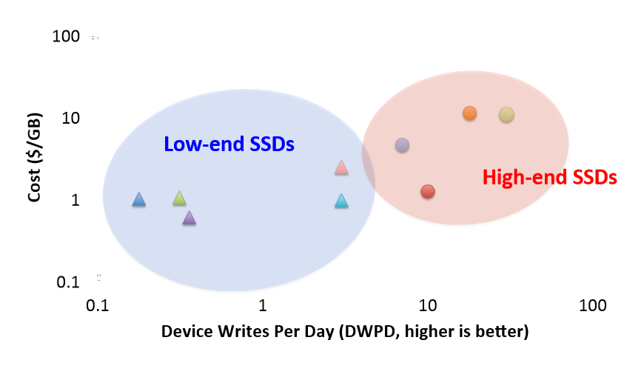
Different classes of SSDs

Slide 4
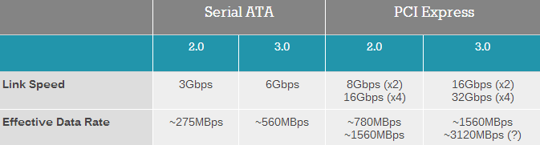
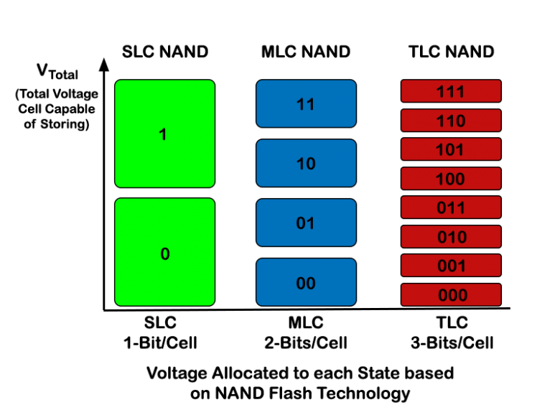
Mixed SSD array
 | High-end SSDs cache | Low-end SSDs main storage
I/O Interface | PCIe interface (Faster) | Serial ATA interface (Slower)
Reliability | SLC eMLC | MLC TLC
Write endurance | 100K | <30K
Cost | Expensive per gigabyte | Cheap per gigabyte

Slide 5
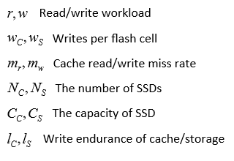
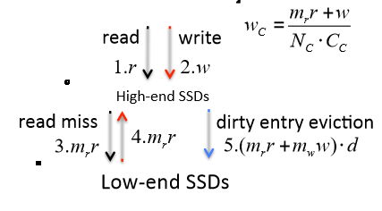
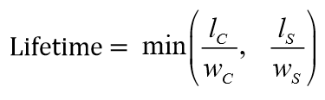
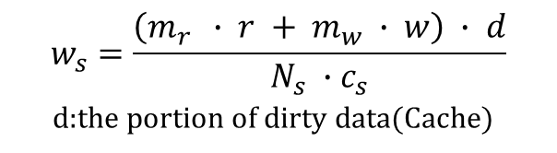
Workload distribution of mixed SSD array
LRU Caching Policy
$$w_{s}=\frac{\left(m_{r } ∙ r + m_{w} ∙ w\right) ∙ d}{N_{s} ∙{ c}_{s}}$$
d:the portion of dirty data(Cache)
Notes:
Black: read request
Red: writes in cache
Blue: writes in main storage

Slide 6
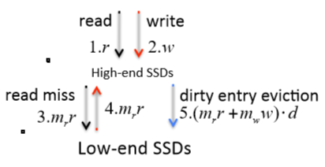
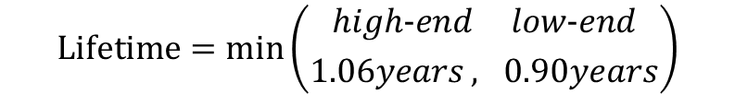


Workload distribution of mixed SSD array
1 high-end SSD cache for 3 low-end SSDs
Item | Description | Specification
High-end (SLC) SSD | Capacity | 100GB
 | Write endurance | 100K
 | Read/write latency | 0.04ms/0.2ms
Low-end (MLC) SSD | Capacity | 200GB
 | Write endurance | 10K
 | Read/write latency | 0.2ms/1.0ms
Workload | Read/write(MB/s) | 160/200
 | R/W cache hit rate | 90%/85%
 | R/W length | 16KB/16KB
 | Dirty data in cache | 65%
$$w_{c}=\frac{160{MB}/s∙0.1+200{MB}/s}{1∙100GB}$$
$$w_{s}=\frac{(160{MB}/s∙0.1+0.15∙200{MB}/s)∙0.65}{600GB}$$
$$Lifetime=min⁡\left({high−end low−end \atop 1.06years , 0.90years}\right)$$

Slide 7
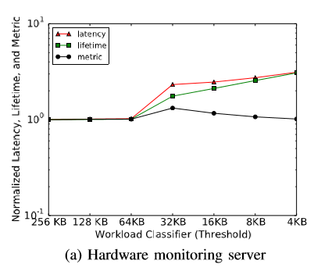
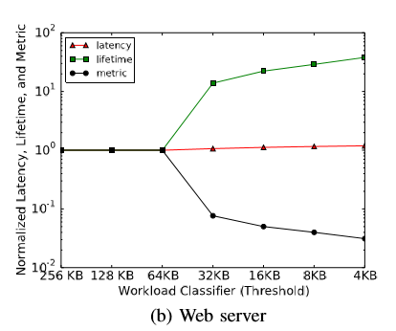
Problem Statement
High-end SSDs cache can wear out faster than low-end SSDs main storage
Caching less results in poor performance
Caching more results in poor reliability
Therefore, Need to distribute workload
Static workload classifiers can be less efficient
The characteristics of workload can change over time
No ideal threshold

Slide 8
Problem statement
Objectives
- Balance the performance and lifetime of cache and storage at the same time
metric: Latency over Lifetime (less if better)
Notes:
Graph: size based

Slide 9
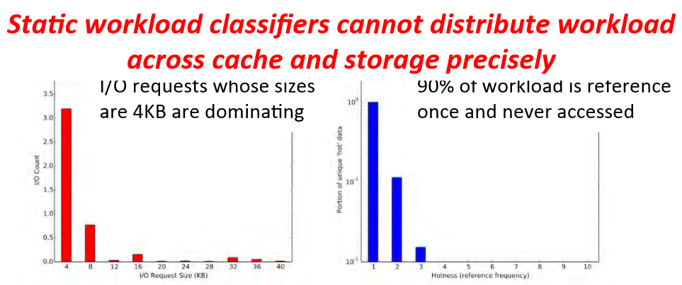
Selective caching policies
Request Size based Caching Policy
Hotness based Caching Policy

Slide 10
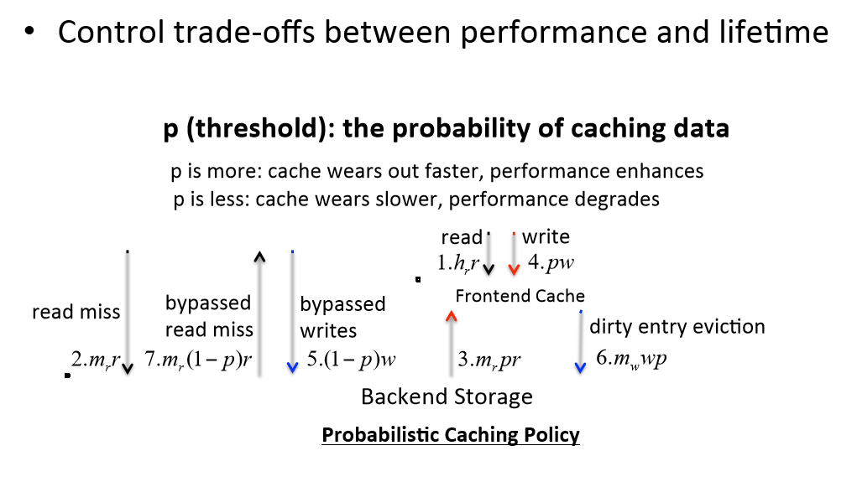
Selective caching policies
Objective: distribute workload

Slide 11
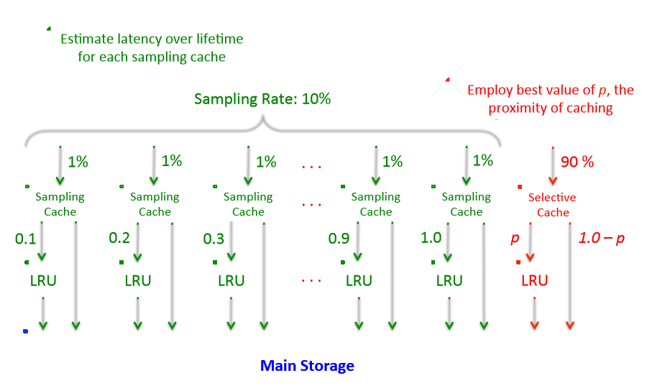
Online sampling

Slide 12
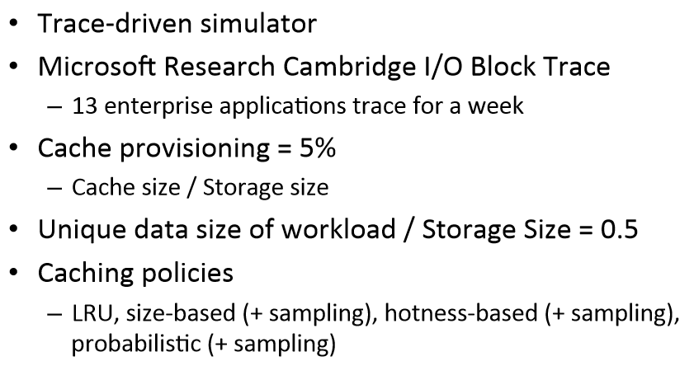
Simulation environment

Slide 13
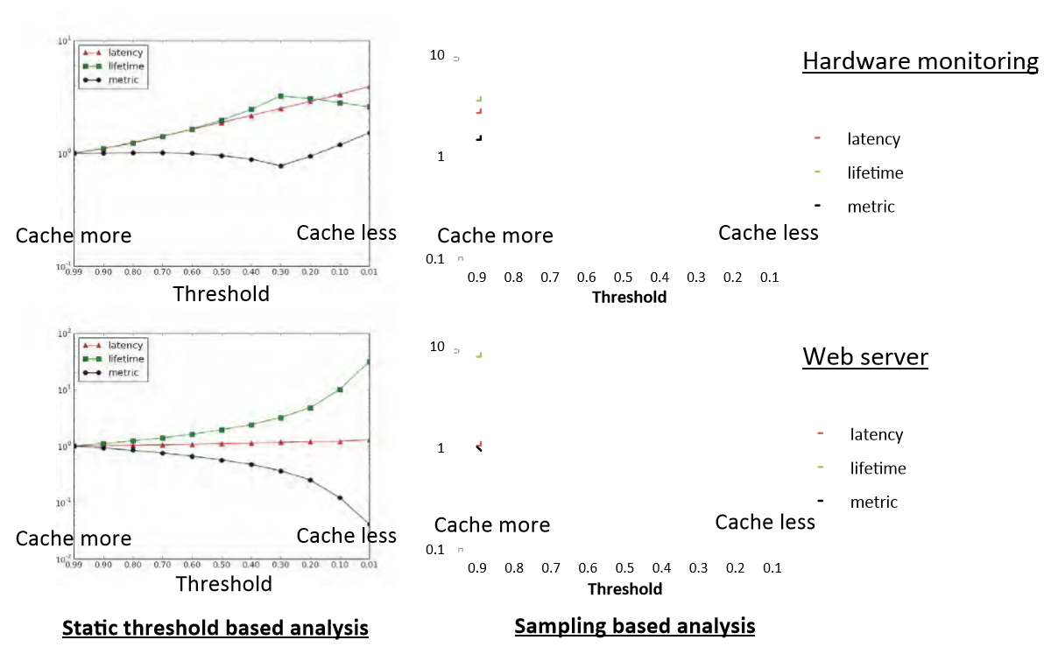
Adaptive threshold

Slide 14
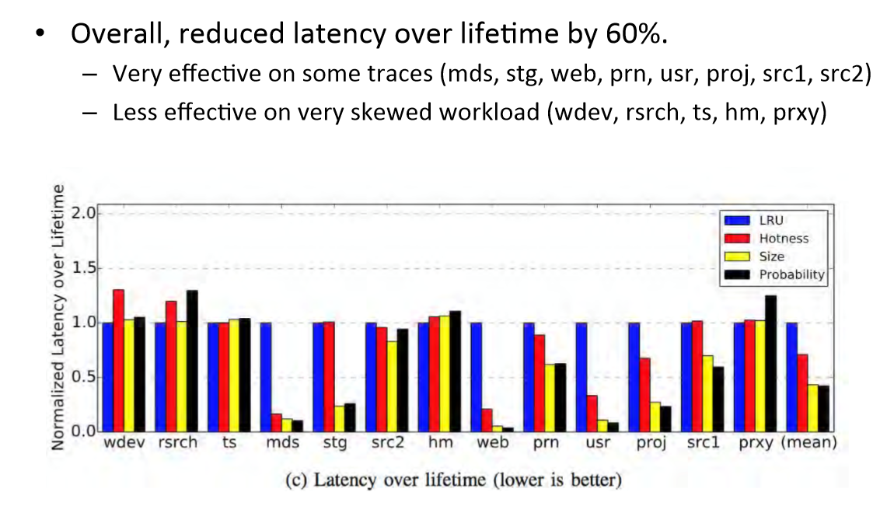
Different workload traces
Notes:
Threshold decrease for workload with weak locality, -> miss rate 높아진다(hit낮다) . , weak locality -> cache wear out 빨라짐,
Effiective: when weak locality , 왜? Avoid weak locality data caching
Strong locality: 의 caching 을 조절 -> p 를 감소시키면 performance에 심각한 손상

Slide 15
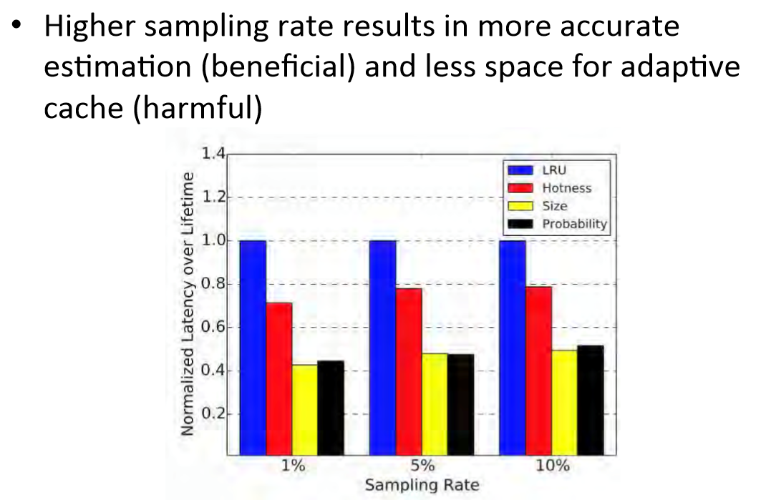
Different sampling rates

Slide 16
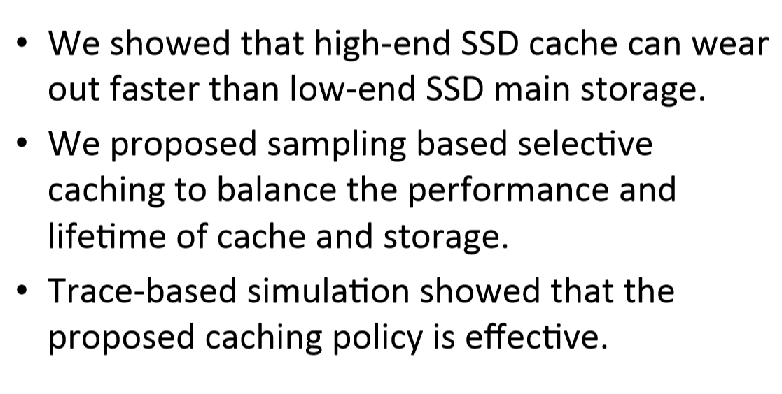
Conclusion

Slide 17


